Slide 1


The Western Indian Ocean- Invasive Species Practitioners Network (WIO-ISPN)
For the Invasive Species Specialist Group
BTech 451 Project 2012
By Afshaa Sacranie

Slide 2
Overview
The WIO-ISPN’s main purpose is for communication and the sharing of information on invasive species. It allows:
Searching of specialists
Registering oneself as a specialist
Searching for information in the form of books, articles, journals, all online resources
Entering resources into the system
Blog

Slide 3
The Tool
After considering many tools, the tool that was chosen is UMBRACO
Umbraco is an open source tool
Language is ASP.Net
Has starter kits for business, normal or blog layouts
The only problem tool is that the blog cannot be used by everyone, only organization moderators are able to post

Slide 4
The Umbraco Controller
Users can sign into this Umbraco Controller to:
add pages,
modify layout,
change code
edit expert/ members
How did I use ASP.Net with Umbraco?
I created user controls in visual studio
Added them as macros to the Umbraco controller
Added these macros to the pages code in the controller
Notes:
Users are different to members
What is a macro
What is a user control

Slide 5
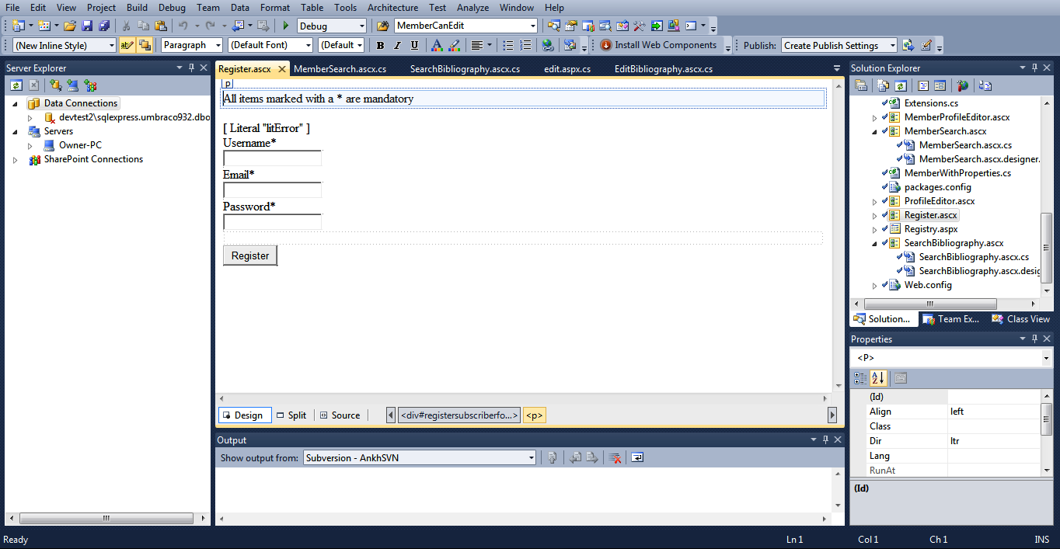
Creating the User Control “Register”

Slide 6
The Database
Microsoft SQL Express
To connect to the database, at first I used simple connection strings but my company mentor showed me that Data Access Layers (DAL) can be used
DAL is a .Net application architecture, DAL typically contain methods for accessing the underlying database data

Slide 7
Database Continued …
To search for resources in SearchBibliography the following connection string was used
SqlDataSource1.ConnectionString=ConfigurationManager.AppSettings["umbracoDbDSN"];
To search for experts in member search the following was used:
var members = q.ExecuteTypedList<DAL.Member>();

Slide 8
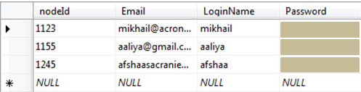
Database Continued …
cmsMember Table Data

Slide 9
Future Work
Missing Implementations
A more specific search engine for both the Bibliography and Experts
Notification emails on the registration of a new expert to both the moderators and the new expert themselves
Address the issue with changing properties of the experts
There is no way in an expert can remove themselves
Translator

Slide 10

What I Have Gained
DAL
Creating user controls and adding them as macros
Tortoise SVN enabled version control:
To get the latest and most stable version of the code
To get old code back
Experience in a working environment

Slide 11

Acknowledgement
Thank you to my academic mentor Ms. Angela Chang and my industry mentors Ms. Shyama Pagad, Mr. Chris Craig and Mr. Mikhail Diatchenko.
Questions

